Slide 1
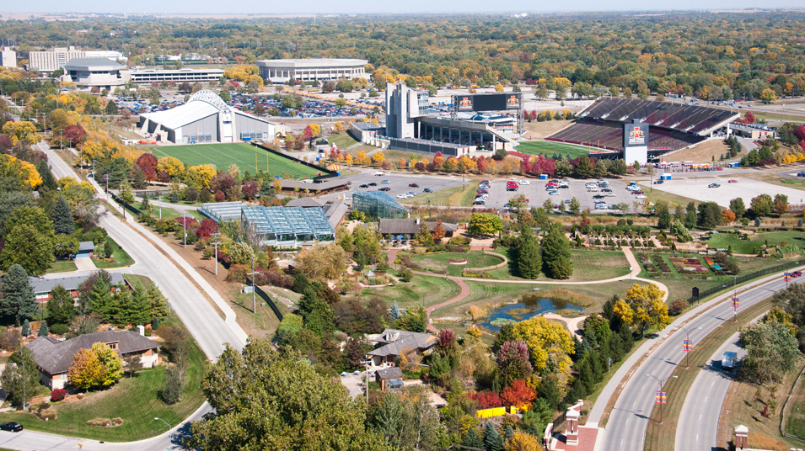
predicting ames housing prices
Project 2
By: Matthew Lio

Slide 2
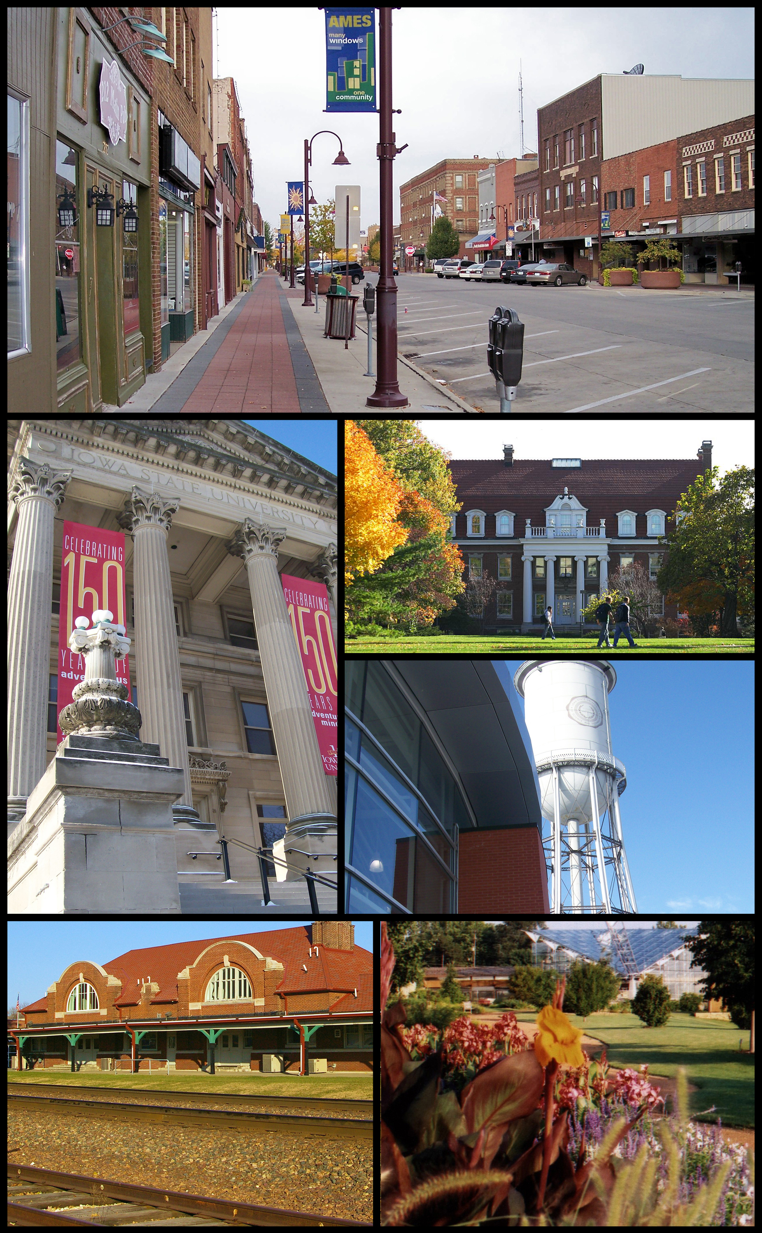
contents
Problem Statement
Background
Production Model Performance
Considerations for Agents
Recommendations

Slide 3

Problem statement
How can we predict the sale price of houses in Ames?
Which features increase or decrease the value of a house?
What features can homeowners add or improve on to increase the value of their house?
What features should investors look out for when buying a house for investment?

Slide 4
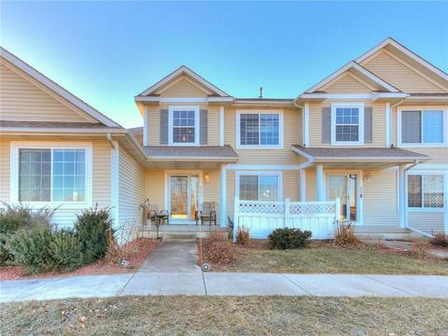
background
2051 residential properties
81 house features
2006 - 2010

Slide 5
background
 | SALE PRICE
MOST EXPENSIVE | $611,657
AVERAGE | $181,469
CHEAPEST | $12,789
 | AREA (SF)
LARGEST | 5642
AVERAGE | 1499
SMALLEST | 334

Slide 6
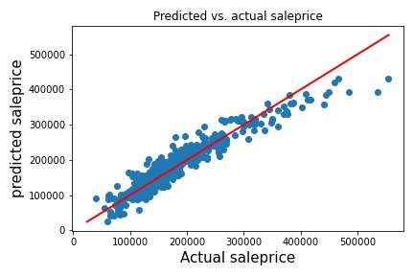
Production model performance
Reasonably well predictions
Slight deviation for higher prices
No overfit

Slide 7

Considerations for real estate agents
Desirable neighborhoods
Top Features
Bottom Features

Slide 8
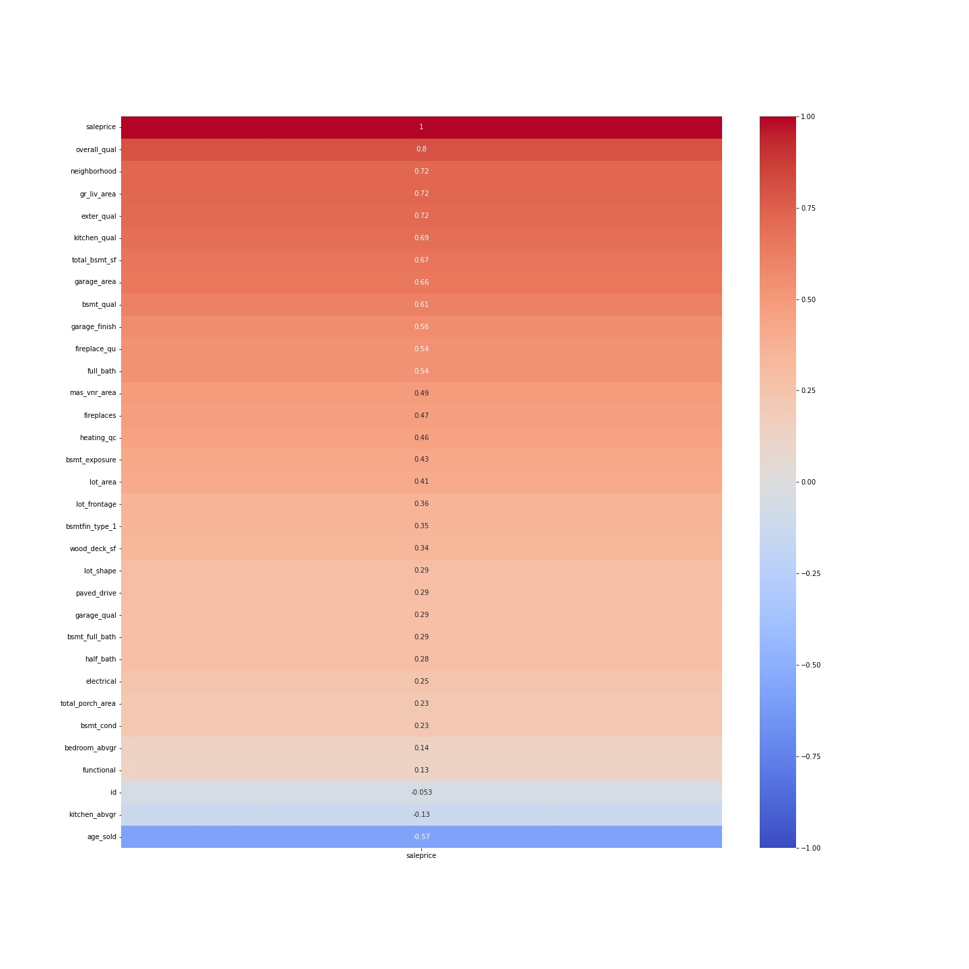
Correlation heatmap

Slide 9
Desirable neighborhoods
TOP 5
STONE BROOKE
NORTHRIDGE HEIGHTS
NORTHRIDGE
GREEN HILLS
VEENKER
BOTTOM 5
BROOK SIDE
OLD TOWN
BRIARDALE
IOWA DOT AND RAILROAD
MEADOW VILLAGE

Slide 10
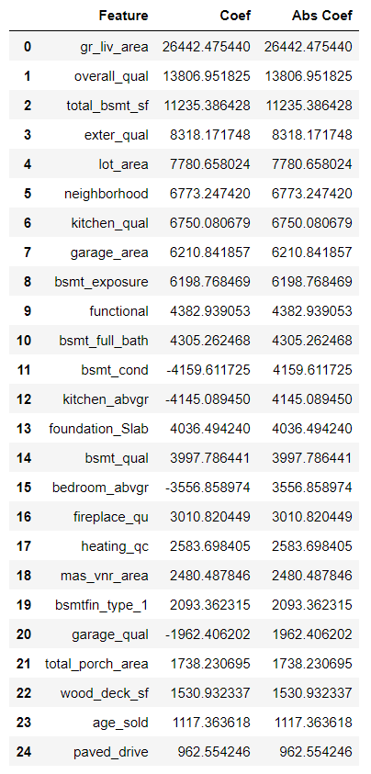
top features
Top features that we are including into our production model

Slide 11
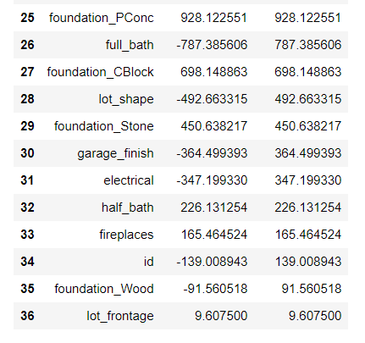
Bottom features
Bottom features that we are excluding from our production model

Slide 12
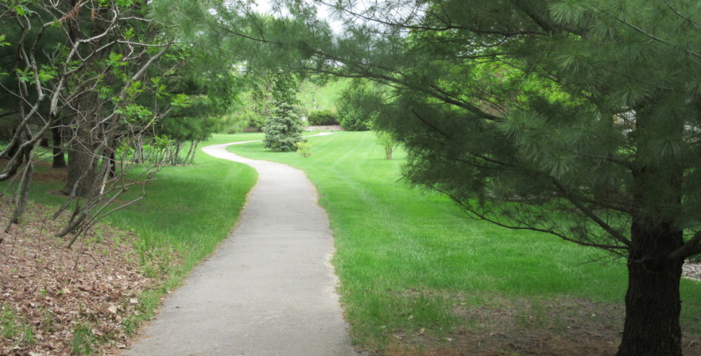
recommendations

Slide 13
For home-seekers
Smaller houses (take a pick)
Small living area
Small basement
Small garage
An older house
Less desirable neighborhood
Lesser masonry area

Slide 14
For investors
Look at top 3 most desirable neighborhoods
Stone Brooke
Northridge Heights
Northridge
Buy low, sell high method, buy without certain features, but install them after purchase
Masonry veneers
Porch areas
Sell as soon as possible

Slide 15
Future improvements
Small time frame limits annual patterns in sale price from external factors like economy or policy changes
Sale prices most likely were not adjusted based on inflation
Dataset is 12 years old
Need more data from a wider time frame

Slide 16
Thank you

